Slide 1
torch.manual seed(3407) is all you need: On the influence of random seeds in deep learning architectures for computer vision
Presenter: Kim Seung Hwan (overnap@khu.ac.kr)

Slide 2
Randomness
SGD and others are seed dependent…
The results of our experiences have come out different every time
I believe everyone will agree 😏

Slide 3
Randomness
However, many papers report only a small number of iterations
This contrasts with traditional scientific papers,
Which do a lot of statistical analysis

Slide 4
Randomness
Picard, David. "Torch. manual_seed (3407) is all you need: On the influence of random seeds in deep learning architectures for computer vision." arXiv preprint arXiv:2109.08203 (2021).
This paper explore the effect of the random seed
Please take it lightly

Slide 5
Experiment Setting
Just experiment a lot…
10000 iteration (with random seeds)
Resnet with arbitrary capacity adjustment (Resnet9)
CIFAR-10 and Imagenet

Slide 6
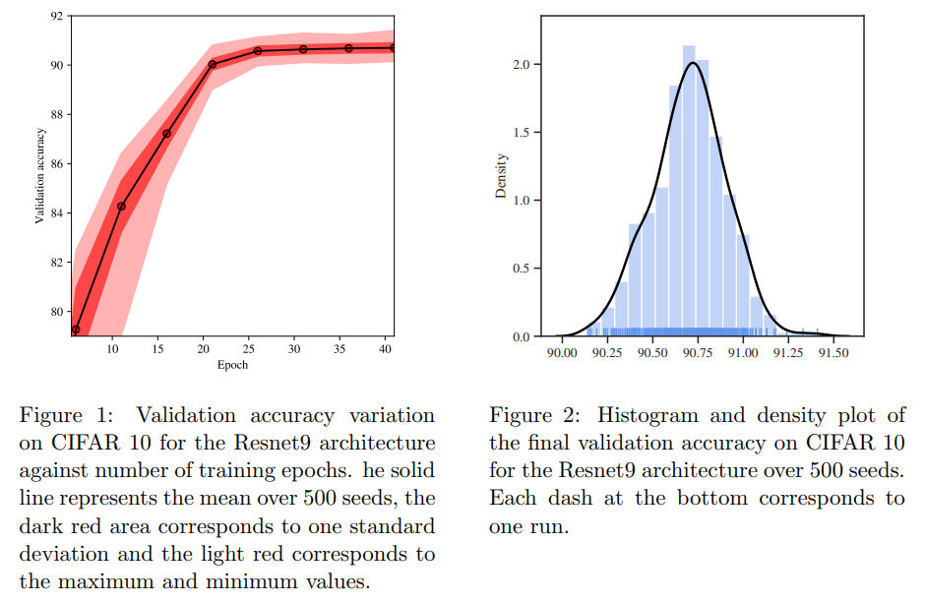
Result

Slide 7
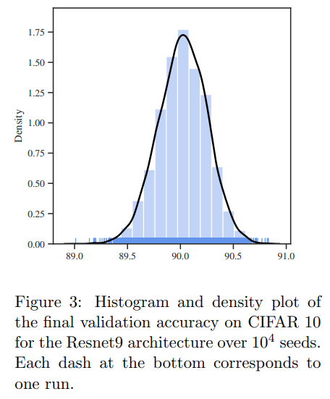
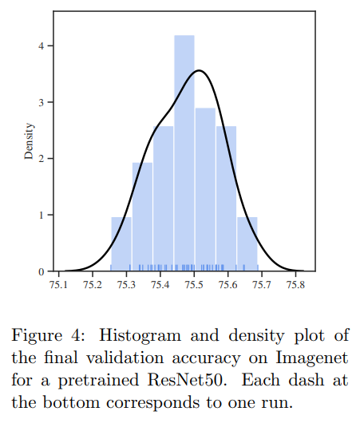
Discussion 1
They are quite mean-concentrated
I think this means that we can have some confidence
in the mean of a small sample size i.e. experiment iterations

Slide 8
Discussion 2
The author reports “the result of each is stable”
The difference by the seed is due to the location at convergence
Rather than instability later in training
“Once the model converged, this distribution is relatively stable which means that some seed are intrinsically better than others.”

Slide 9
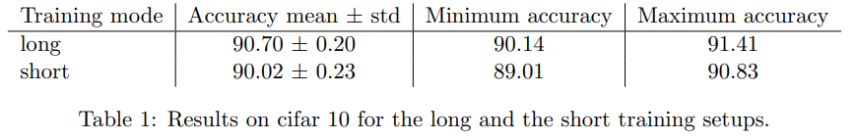
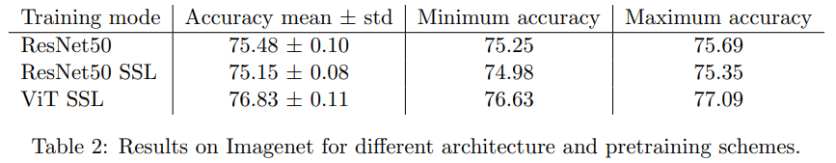
Discussion 3
In many cases the random seed is almost irrelevant
But outliers are easy to find
Approx 1%
Approx 0.5%

Slide 10
Thank you for listening
Presenter: Kim Seung Hwan (overnap@khu.ac.kr)

